Slide 1



DM2
Symptoms Overview
Giovanni Meola, MD, PhD

Slide 2
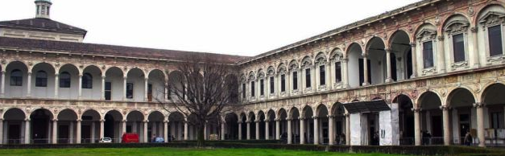
Outline
Etiology of DM
Clinical and Laboratory Features
Multisystemic disease
Take Home Message
Dr Meola has nothing to disclose

Slide 3

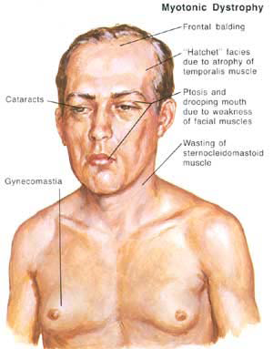
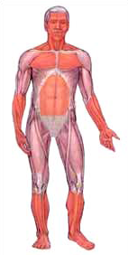
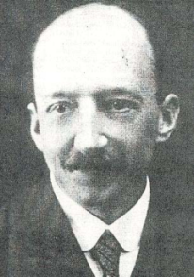
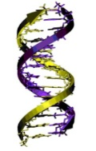
Myotonic Dystrophies
In 1909, Steinert; Batten & Gibb independently described the disorder focusing on muscle disease.
Complex multisystemic phenotype (eyes, heart, endocrine, SNC) (see Harper 2001).
Argument: one disease or many?
Up to 1986 or so, no presymptomatic, or prenatal tests.
DM 1 mutation identified at 3’UTR of DMPK gene
In 1909, Steinert; Batten & Gibb independently described the disorder focusing on muscle disease.
PROMM-DM2 phenotype and mutation defined (Thornton; Ricker; Meola)
Indirect evidences of Mapping on Chr 19
1909 1970’ 1982 1992 1994-01
Systemic review of pedigrees and clinical features (Harper et al.)
Antigen Mapping: Lu(a+); ABH, peptidaseT, Lewis, C3

Slide 4
Etiology of DM

Slide 5
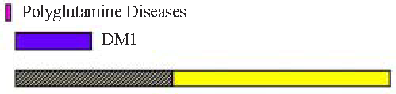
Etiology of DM type 1 and 2
DM1 DM2
Chromosomal locus 19q 13.3 3q 21.3
Gene DMPK ZNF9/CNBP
Inheritance autosomal dominant autosomal dominant
Mechanism CTG repeat expansion CCTG repeat expansion
Normal repeat size <37 <27
Pathologic repeat size >50 >75?
Expanded repeat range 50-4000 75-5000->11000
Anticipation yes ----
DM2

Slide 6
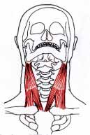
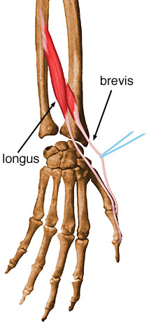
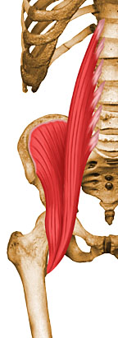
Myotonic Dystrophy type 2
DM2/PROMM typically presents in adulthood between 20 years and 50 years of age.
Has variable manifestations:
  early onset cataracts (<age 50 years),
  various grip myotonias
  thigh muscle stiffness
  muscle pain
  Weakness to 3 top muscles: Sternocleidomastoid muscle
  Extensor pollicis longus
  Iliopsoas muscle

Slide 7
Myotonic Dystrophy type 2
the onset of symptoms in DM2 occurs later in adulthood than in DM1
diagnostic delay in DM2 is often challenging because many patients lack core elements of DM: - clear dominant inheritance
- myotonia on clinical exam
- obvious electromyography (EMG) abnormalities
- cataracts
many symptoms of DM2 resemble the diffuse muscle pain and stiffness associated with other disorders (fibromyalgia) and delay accurate diagnosis
with many potential misdiagnosed and undiagnosed patients, the prevalence of DM2 is likely higher than currently assumed
DM2 may be as prevalent as DM1 in certain countries

Slide 8
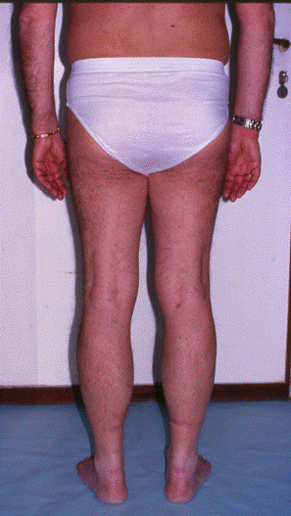
Myotonic Dystrophy Type 2

Slide 9
DM2: clinical spectrum

Slide 10
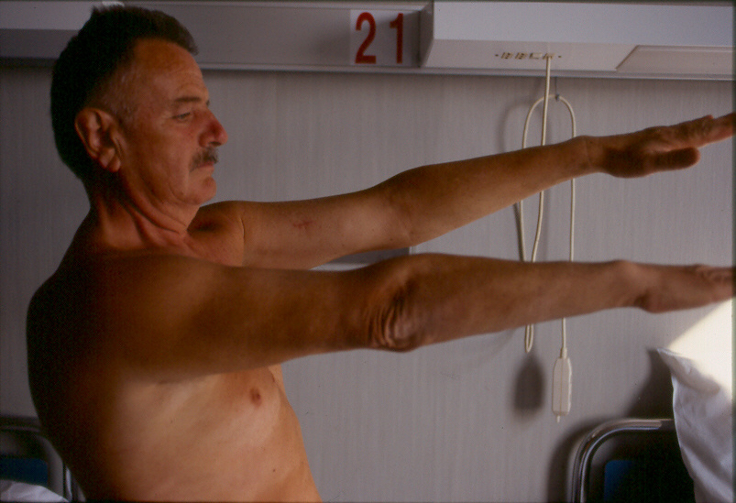
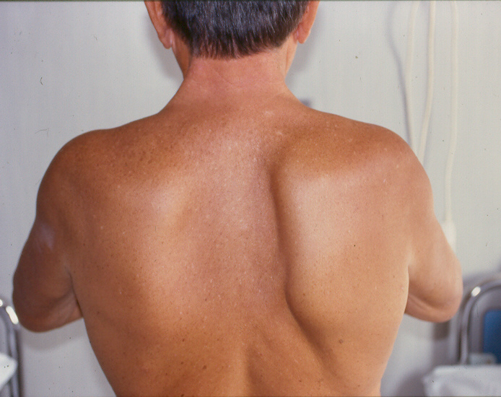
DM1 phenotype
Proximal and distal atrophy
Grade 4 MRC proximal and distal muscle weakness
Facial muscle involvement
Balding

Slide 11
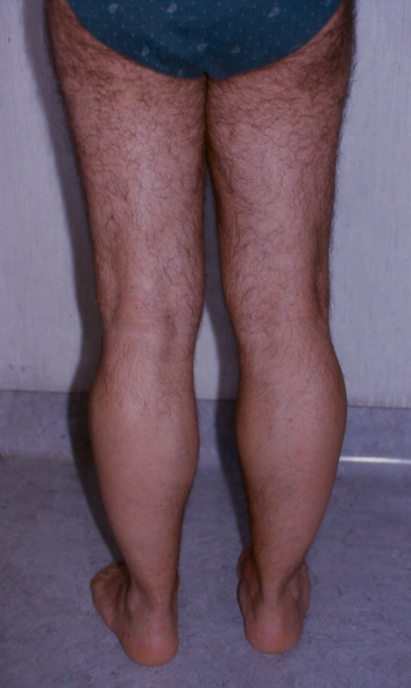
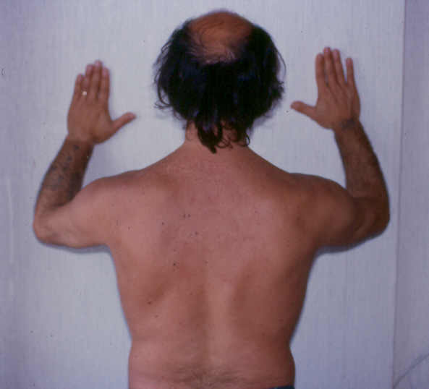
PROMM phenotype
Mild atrophy
Grade 4 MRC proximal muscle weakness

Slide 12
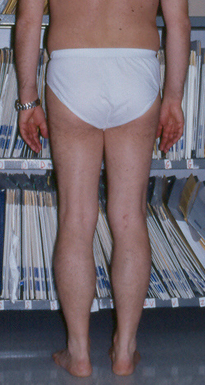
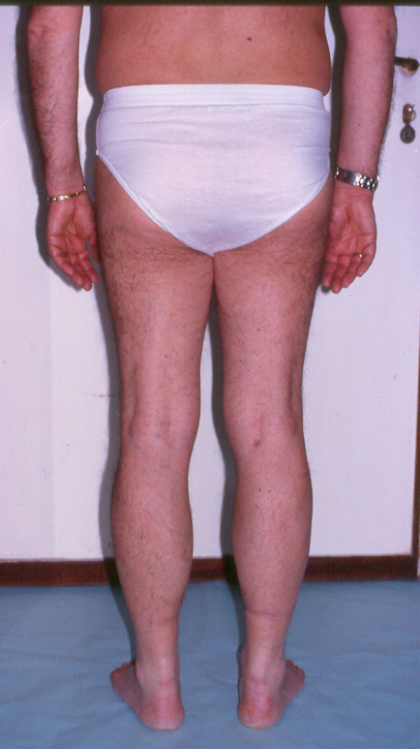
PROMM phenotype
Mild atrophy
Grade 4 MRC proximal muscle weakness
Slow progression
1997
2000

Slide 13
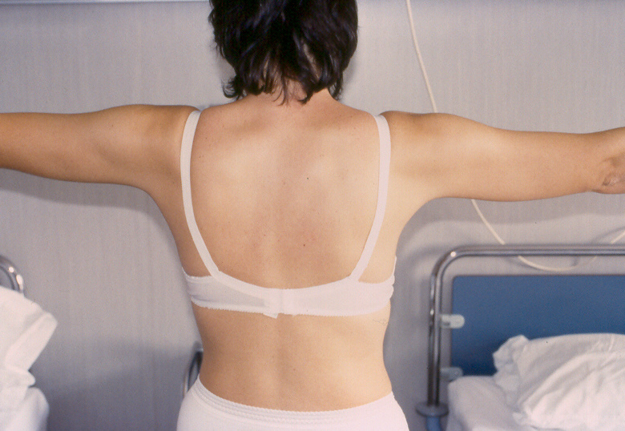
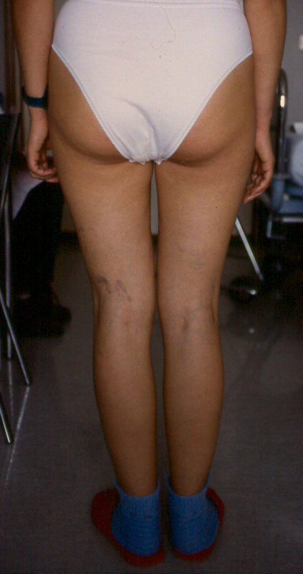
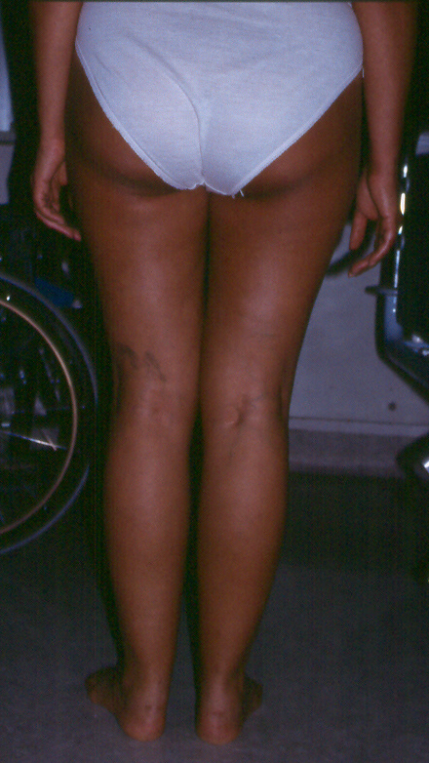
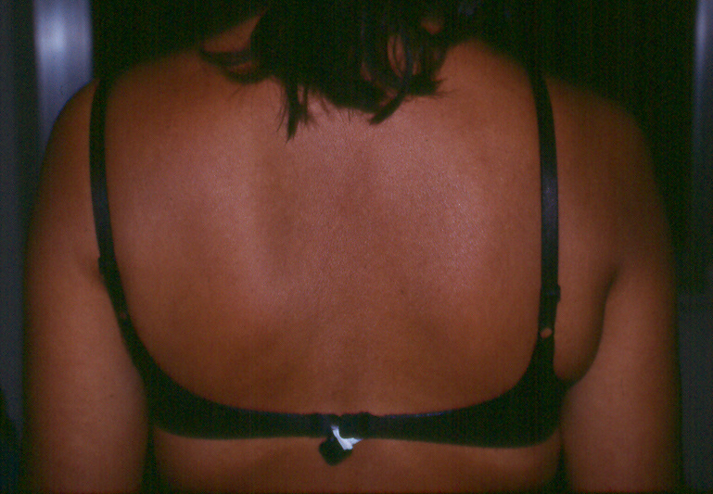
PROMM phenotype
1998
2005
Mild atrophy
Grade 4 MRC proximal muscle weakness
Slow progression
2005

Slide 14
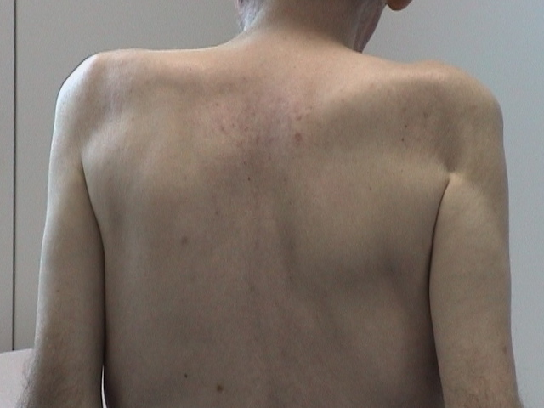
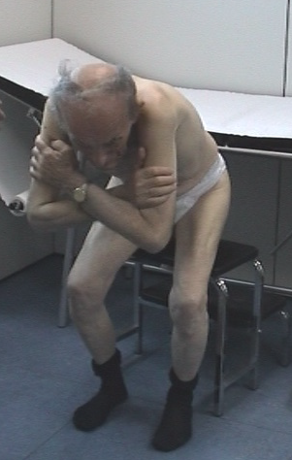
PDM phenotype
Severe atrophy
No cataracts
No clinical myotonia
Rotondo et al. 2005

Slide 15
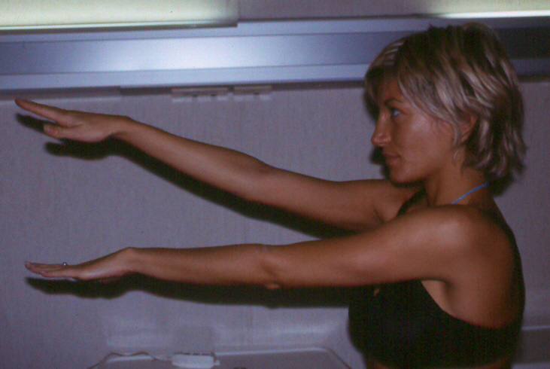
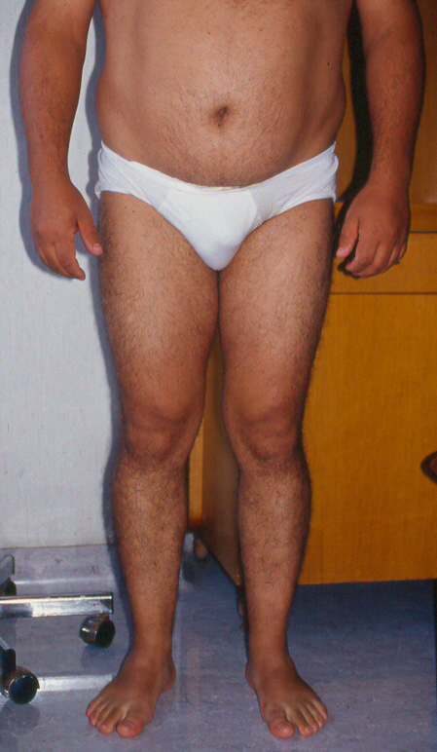
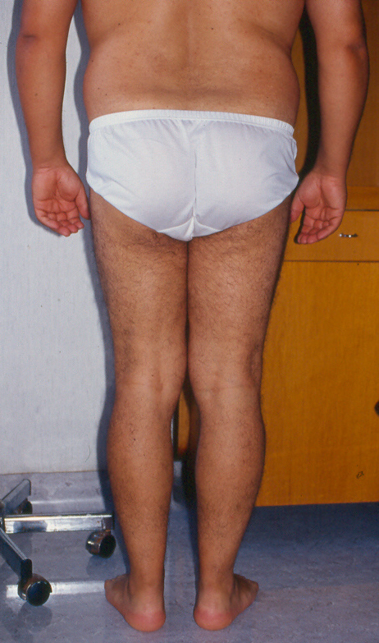
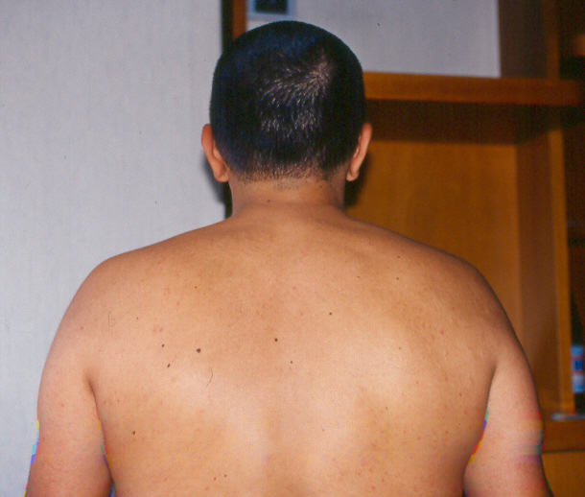
Presymptomatic
High CK
Merlini L et al. Muscle & Nerve 2005
Muscle pain
  4/86 patients: Italian experience
  observational period: mean follow-up: 8 ± 2.4 years

Slide 16
Pain in DM2
2
Pain in thighs, back and proximal muscles
Tenderness in the muscles
Symptoms enhanced by cold, static posture and heavier exercise
In 30% of DM2 patients, muscle pain is the most disabling symptom and increases with disease duration
Schneider C, Gold

Slide 17
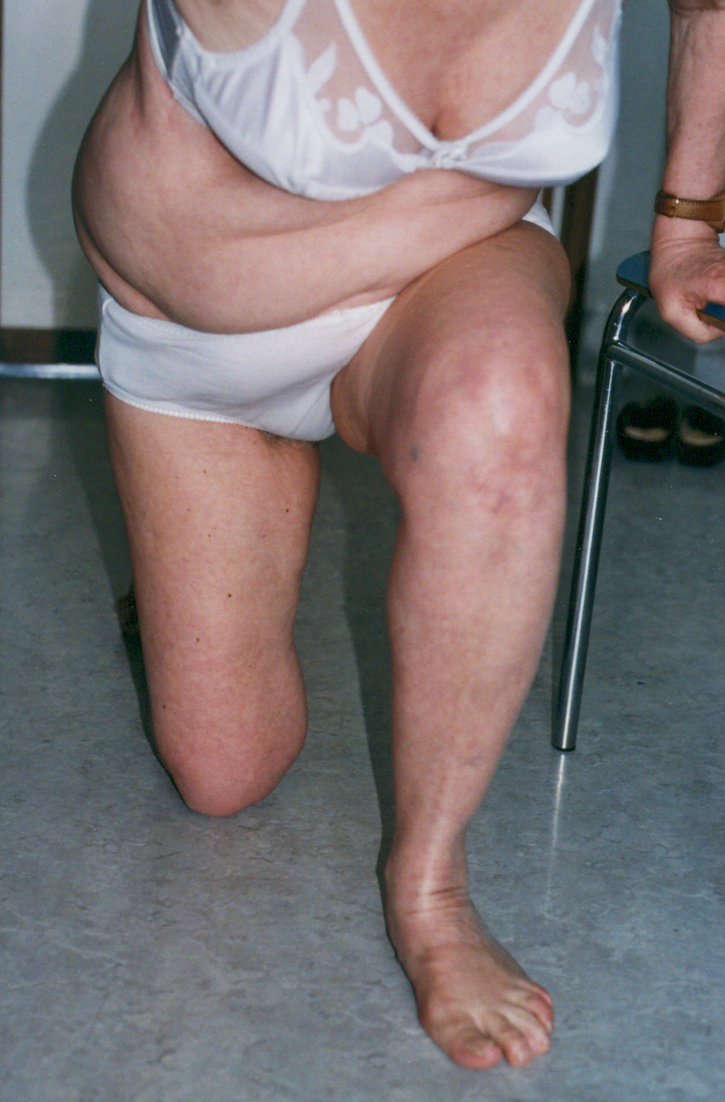
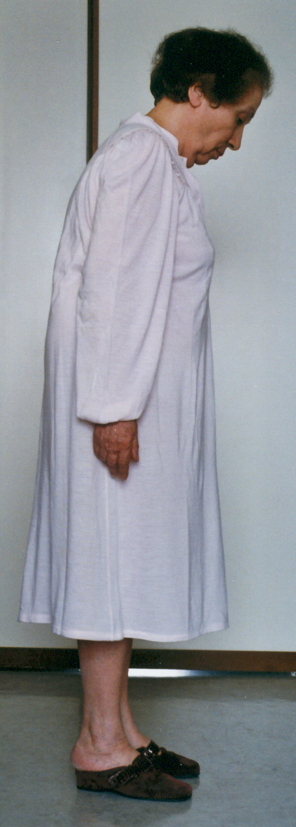
CNS predominant
Dementia-like
  IQ < 70 in 2/86 with MMRC 140/150
  - (AAN2005)
Extrapyramidal traits suggesting PD
  3 case-reports
    - Serratrice J et al. Press Med 2000)
    - Sansone et al. J Neurol Neurosurg Psychiatry 2006)

Slide 18
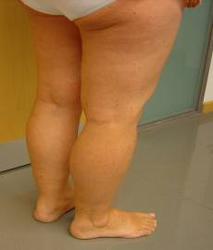
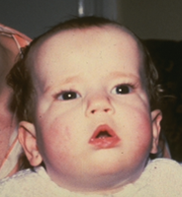
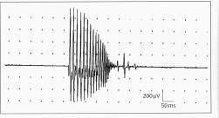

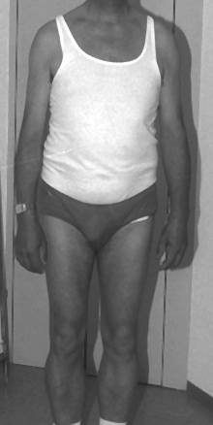
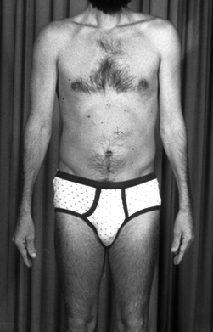
Myotonic Dystrophies
DM1
DM2
DM1 specific
at the beginning
prominent distal weakness
distal muscle atrophy
congenital DM1
- retardation
- hypotonia
facial diplegia
“tent”-mouth
gastrointestinal problems
life expectancy reduced
Onset 0-50y
DM Core
myotonia
muscle weakness and atrophy
face, neck, finger, axial
early cataracts
cardiac arrhythmias
dilative cardiomyopathy
cognitive dysfunction
hypersomnia
hyper-GGT
insulin resistance
testicular atrophy
frontal balding
hypogammaglobulinemia
muscle pain
DM2 specific
at the beginning
prominent proximal weakness
proximal muscle atrophy
calf hypertrophy
tremor
Onset >15y; mean >40y
DM core pattern

Slide 19
Clinical and laboratory features

Slide 20
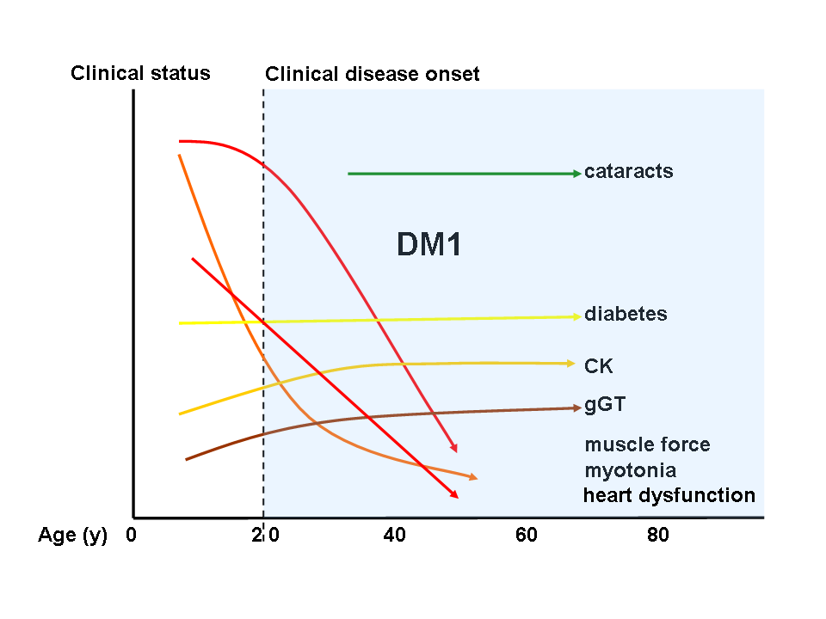
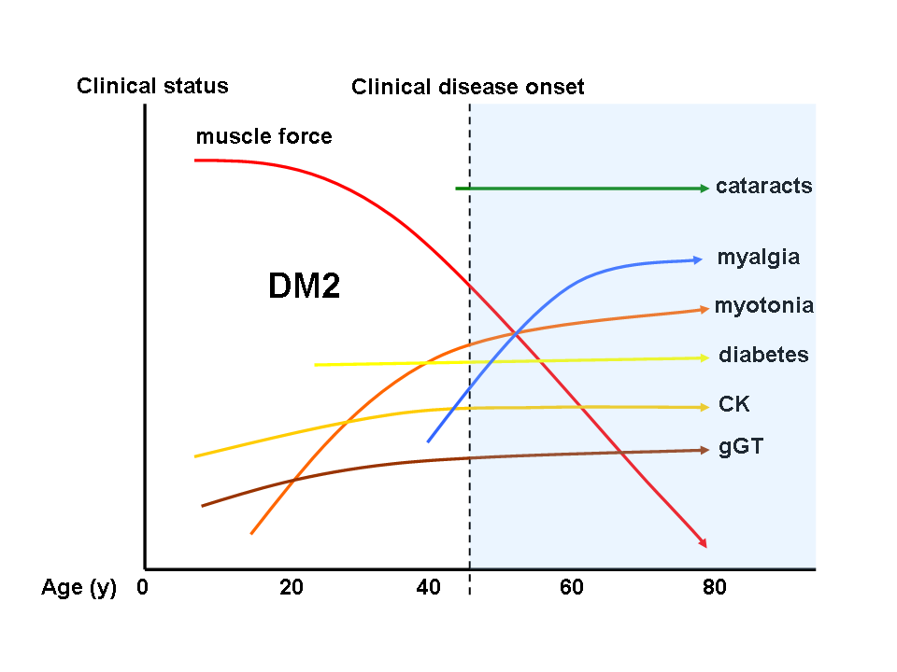

Slide 21
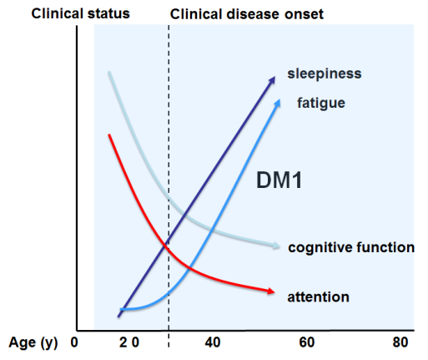
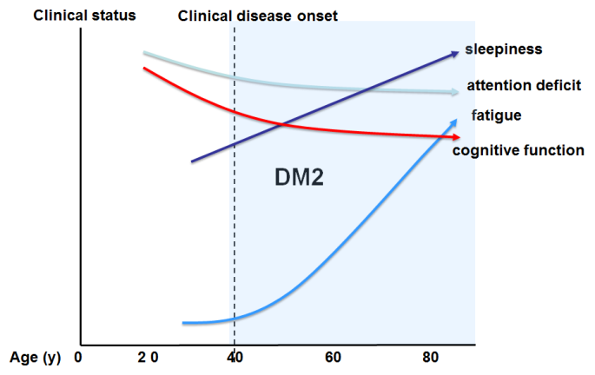

Slide 22
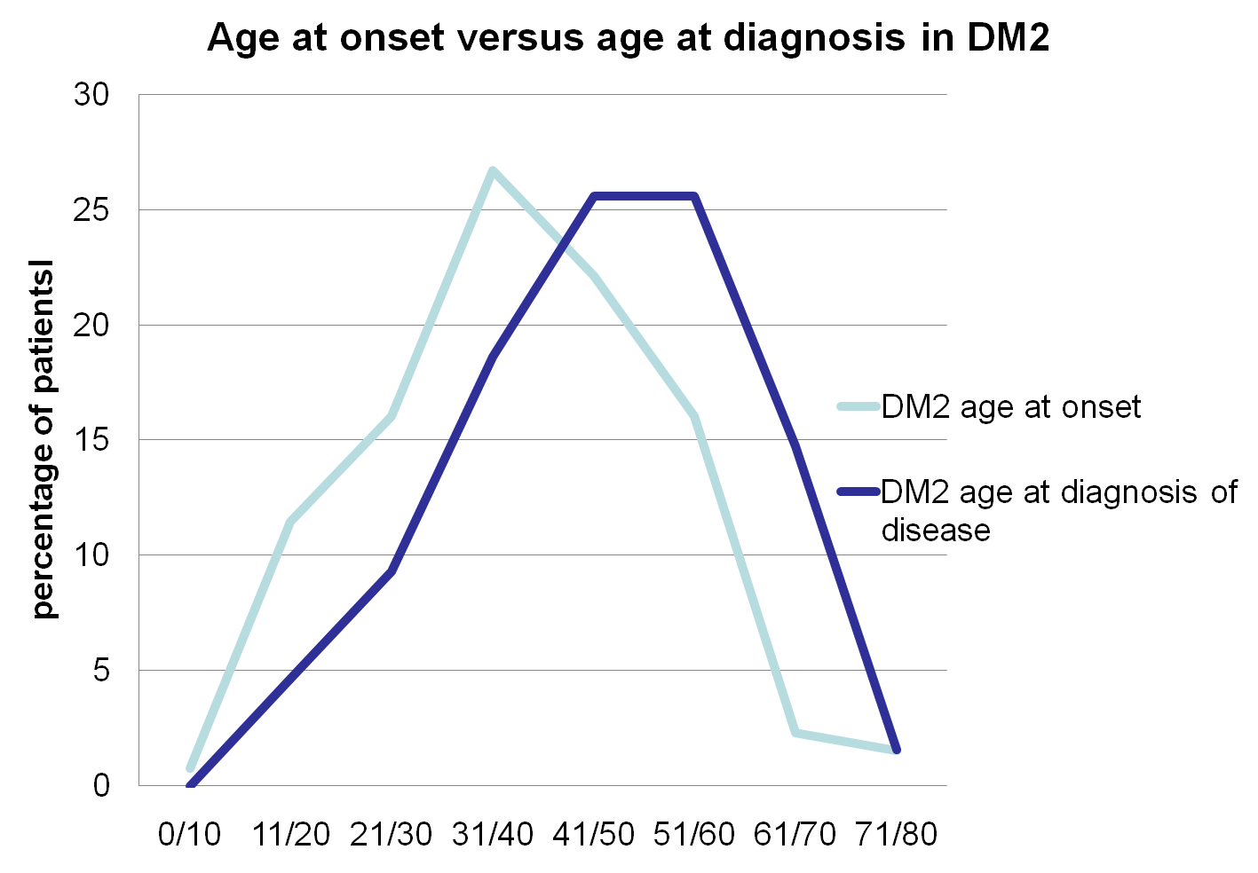
Age at onset:
40 years ±13.8
Age at diagnosis
47 years ±13.9

Slide 23
Summary of the pathological findings
118 DM2 biopsies
Structural changes Number of Percent of Biopsies Biopsies
Increased internal nuclei 118 100%
>5 63 53%
<5 55 47%
Pyknotic nuclear clumps 92 83%
Necrosis 44 40%
Increased fiber size variability 118 100%
Angulated atrophic fibers 113 96%
Hypertrophic fibers (>80µm) 33 33%
Small grouped atrophy (<10 fibers) 37 30%
Ring fibers 21 18%
Moth-eaten fibers 18 16%
Connective tissue proliferation 14 12%
⇒ No targets and/or fiber type grouping

Slide 24
Conclusions
No pathognomonic bioptic criteria of DM2,
But
predominant non-selective MHC type 2A
myofiber atrophy
predominant myopathic features combined with „denervation-like“ features
wide spectrum of morphological features(~DM1)
muscle biopsy of the quadriceps femoris or biceps brachii muscle is recommended

Slide 25
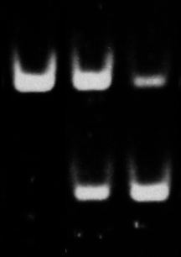
DMs muscle biopsy synopsis
No pathognomonic myopathological criteria
DM1 knowledge based on rather old studies
Multiple central nuclei DM1=DM2
Ring fibers sarcoplasmic masses DM1>>DM2
Myosin slow fiber atrophy DM1>>DM2
Myosin fast fiber atrophy DM2>>DM1
wide spectrum of morphological features in both
The BIN 1 story
DM2 Biopsy
DM1 Biopsy
CTL
BIN1 + ex 11
Courtesy of
Nicolas Charlet-Berguerand
BIN1 - ex 11
Nature medicine 17:720-726;2011

Slide 26

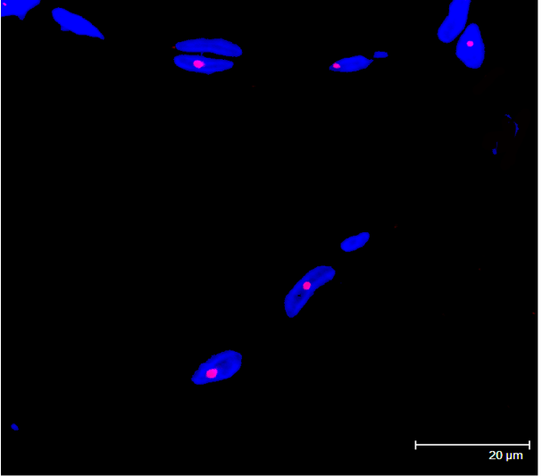
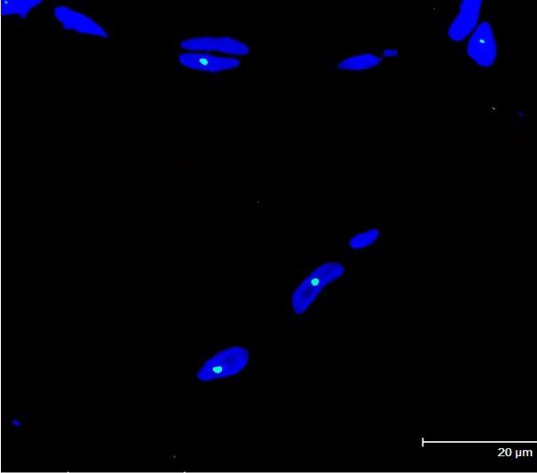

FISH
FISH
Cardani et al., 2004
fluorescence in situ hybridization with a specific probe (CAGG)5 combined with MBNL1-immunofluorescence
ribonuclear inclusions colocalizing with MBNL1 foci
α-MBNL1
merge
(CAGG)₅-Texas Red
DAPI
useful technique for DM2 diagnosis
Notes:
Le canalopatie muscolari sono un gruppo di malattie ereditarie che causano due sintomi principali: la miotonia e le paralisi ricorrenti. Sulla base della sintomatologia possiamo quindi considerare due grandi gruppi: da una parte le paralisi periodiche, dall’altra le miotonie non distrofiche. Ci puo essere cmq una sovrapposizone dei sintomi (uno spettro di malattia). Si va da fomr puramente miotoniche, a forme puramente paralitiche a forme intermedie.
Piu grande studio epidemiologico:
Horga A total of 665 patients fulfilled the inclusion criteria, of which 593 were living in England, giving a minimum point prevalence of 1.12/100,000.
Ricordati che si basa solo sui casi geneticamente confermati.

Slide 27
Multisystemic disease

Slide 28
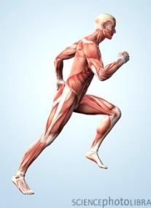
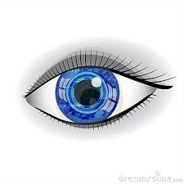
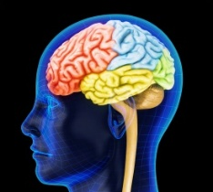
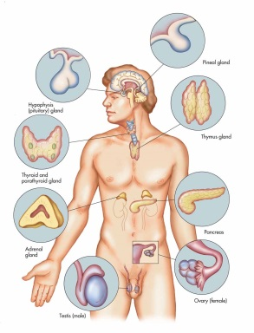

Multisystemic disease
Skeletal muscle involvement
cataract
multisystemic diseases
brain involvement
endocrine system involvement
cardiac involvement

Slide 29
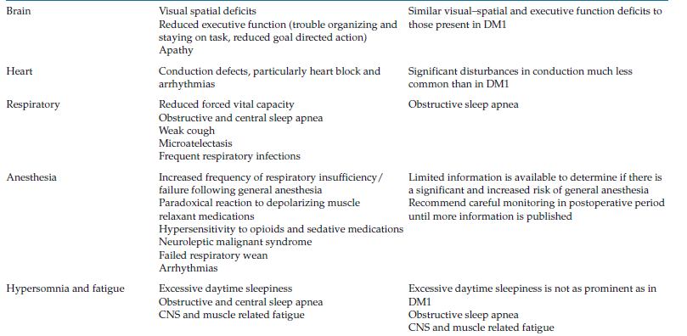
Myotonic Dystrophy Type 2
Adult- onset DM2/PROMM
Notes:
Le canalopatie muscolari sono un gruppo di malattie ereditarie che causano due sintomi principali: la miotonia e le paralisi ricorrenti. Sulla base della sintomatologia possiamo quindi considerare due grandi gruppi: da una parte le paralisi periodiche, dall’altra le miotonie non distrofiche. Ci puo essere cmq una sovrapposizone dei sintomi (uno spettro di malattia). Si va da fomr puramente miotoniche, a forme puramente paralitiche a forme intermedie.
Piu grande studio epidemiologico:
Horga A total of 665 patients fulfilled the inclusion criteria, of which 593 were living in England, giving a minimum point prevalence of 1.12/100,000.
Ricordati che si basa solo sui casi geneticamente confermati.

Slide 30
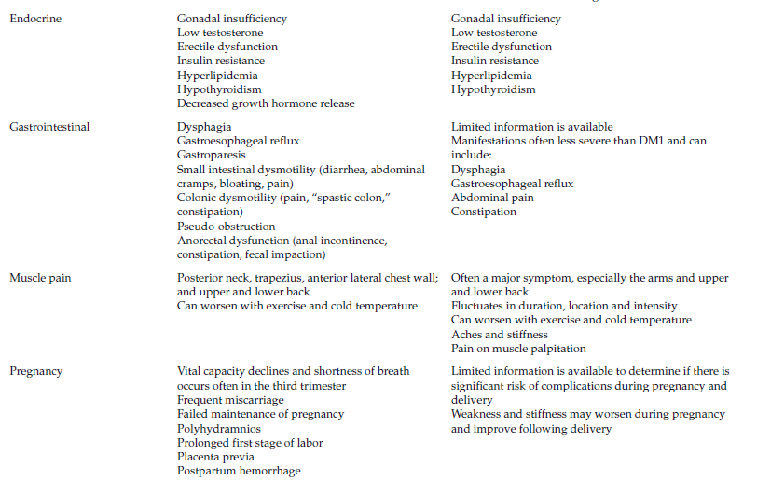
Myotonic Dystrophy Type 2
Myotonic Dystrophy
Type 2
Adult- onset DM2/PROMM
Notes:
Le canalopatie muscolari sono un gruppo di malattie ereditarie che causano due sintomi principali: la miotonia e le paralisi ricorrenti. Sulla base della sintomatologia possiamo quindi considerare due grandi gruppi: da una parte le paralisi periodiche, dall’altra le miotonie non distrofiche. Ci puo essere cmq una sovrapposizone dei sintomi (uno spettro di malattia). Si va da fomr puramente miotoniche, a forme puramente paralitiche a forme intermedie.
Piu grande studio epidemiologico:
Horga A total of 665 patients fulfilled the inclusion criteria, of which 593 were living in England, giving a minimum point prevalence of 1.12/100,000.
Ricordati che si basa solo sui casi geneticamente confermati.

Slide 31
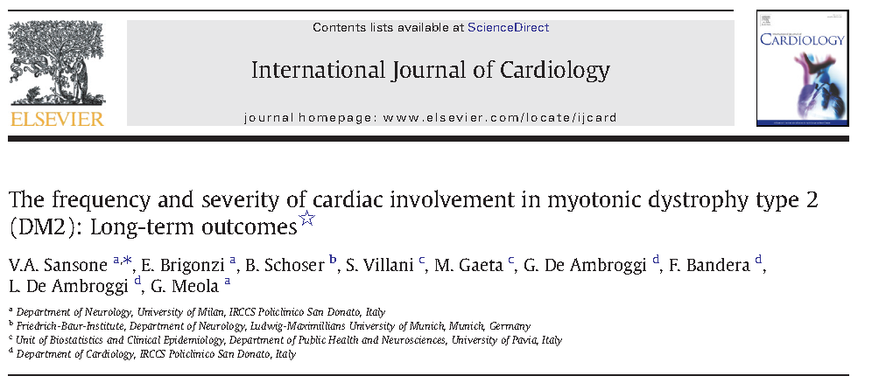
Cardiac involvement
Sansone et al., 2013
the frequency and progression of cardiac and muscle involvement have been studied in a large cohort of patients with DM1 and DM2 in Italy and Germany
the frequency and severity of cardiac involvement and muscle weakness are reduced in DM2 compared to DM1
in DM2 progression is slower and less severe
HOWEVER
careful cardiac evaluation is recommended to identify DM2 patients at risk for potential cardiac major arrhythmia

Slide 32
Cardiac involvement
Cardiac involvement
Freyermuth et al., 2016
in DM1 and DM2 heart samples the adult SCN5A exon 6B is partly replaced by its fetal exon 6A
the switch from adult exon 6B towards fetal exon 6A has been artificially forced into wild-type adult mouse heart using an exon-skipping strategy
misregulation of the splicing of SCN5A participates in a subset of electrical cardiac alterations namely the cardiac-conduction delay and the heart arrhythmias

Slide 33
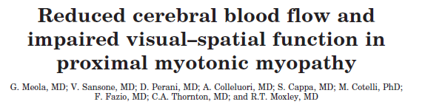
Brain involvement
Meola et al., 1999
DM1
Brain MRI was normal, or showed only nonspecific white matter abnormalities
PET studies showed a more widespread hypoperfusion that extended to the dorsolateral frontal cortex and subcortical regions
DM2/PROMM
Brain MRI was normal, or showed only nonspecific white matter abnormalities
PET studies showed a bilateral decrease in regional cerebral blood flow of the orbitofrontal and medial frontal cortex,
Impaired visual–spatial function may be present in DM2 that correlates best with a reduction in regional cerebral blood flow observed by PET brain scans rather than with specific structural abnormalities observed on brain MRI.

Slide 34
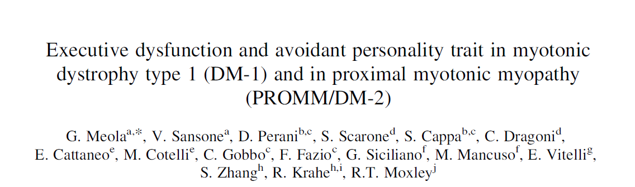

Brain involvement
Meola et al., 2003
DM1 vs DM2
DM1 and DM2 patients had significantly lower scores on tests of frontal lobe function compared to controls
in DM1 and DM2 neuropsychiatric interviews demonstrated an avoidant trait personality disorder
Brain single photon emission computed tomography showed frontal and parieto-occipital hypoperfusion in DM2 patients
The specific cognitive and behavioural profile observed in PROMM/DM-2 and in DM-1, and that this profile is associated with hypoperfusion in frontal and parieto-occipital
regions of the brain.

Slide 35

DTI study on brain function in DM type 1 and 2
Increase of mean diffusity of fractional anisotropy
changes between DM1 vs. DM2 and Co
White matter disease with a callosal body
and limbic system pathology
Depression and mood alterations do negatively
correlate with the white matter alterations in young patients
Courtesy of M. Minnerop
Brain, 2011

Slide 36


MRI Myotonic Dystrophies type 1 and 2
DM1
DM2
frequent!
rare!
from Kornblum et al. J. Neurol 2004

Slide 37


Brain involvement
Rakocevich-Stojanovic et al., 2016
Transcranial sonography
40 genetically confirmed DM2 patients vs 38 gender- and age-matched healthy controls
Brainstem raphe hypoechogenicity was more common in DM2 patients compared with CTR
Brainstem raphe hypoechogenicity was more common in patients with fatigue and excessive daytime sleepiness (P<0.05).
Diameter of the third ventricle was increased in DM2
TCS revealed alterations in brain structures previously not seen in MRI studies

Slide 38


Brain involvement
Maurage et al., 2005
similar tau pathology has been observed in the CNS of DM1 and DM2 patients
the occurrence of Neuro Fibrillary Tangles (NFTs) and Marinesco bodies have been reported in brain tissue from one patient with DM2
Brain tissue from patients with DM1 and DM2 lacks tau-immunoreactive NFTs containing tau-E2 and tau-E3.
NFTs lacking tau-E2 and tau-E3 immunoreactivity might indicate an abnormal synthesis of the tau protein isovariants underlying a physiopathology similar to that observed in DM1.

Slide 39


Respiratory involvement
Leonardis et al., 2015
respiratory functions were lower in DM2 than in the controls; however, they were not as obvious as in patients with DM1
polysomnography showed no difference in sleep efficiency, the number of arousals, or any sleep latencies between DM and controls; no hypoventilation
a significantly greater proportion of time in stage 3 and REM sleep, and a shorter time in stage 2 in the DM2 than in controls
Lower respiratory volumes and pressures, abnormalities in AGA, night oxygen desaturation and higher EtCO2 are present in DM2, but less pronounced than in DM1
Small CMAP amplitudes were presented in DM2, correlating with smaller respiratory functions and poorer sleep quality
AHI was abnormal in 38% of DM2, mainly due to obstructive apneas
sleep disorders and breathing impairments are common in DM
Diaphragm weakness and sleep apneas might be present in patients with DM2
regular questioning about symptoms of respiratory insufficiency
monitoring of phrenic CMAP. PSG should be recorded, when patients have suggestive symptoms, abnormalities in AGA or higher BMI.

Slide 40



EMG Myotonia
Szmidt-Salkowska et al., 2014
EMG recordings obtained from four muscles (two proximal and two distal) showed significant differences between DM1 and DM2.
in DM2, mean amplitude, duration and SI of MUPs recorded in lower limb muscles and mean SI in BB muscles were significantly increased as compared to DM1
50% of RF and TA muscles in DM2 showed high amplitude potentials compared to only 25.5% of TA and 18.1% of RF muscles in DM1
high amplitude potentials in lower limb muscles in DM2 patients, atypical for myogenic muscle lesions, could be explained by muscle fiber hypertrophy observed in muscle biopsies.

Slide 41
Multisystemic concomitant diseases in DM2 patients
Medical condition | DM2 patients
Adipositas, BMI > 28 | 71.6 %
High blood pressure | 38.8 %
COPD/ emphysema | 24.6 %
Diabetes | 18.7 %
type 2 | 16.5 %
type 1 | 2.2 %
Asthma bronchiale | 18.6 %
Pneumonia | 15.7 %
Gallstones | 14.2 %
Arteriosclerosis | 13.4 %
Coronary heart disease | 13.2 %
Fatty degeneration of the liver | 9.7 %
Myocardial infarction | 8.0 %
Stroke | 3.7 %
Pancreatitis | 2.2 %

Slide 42
Multisystemic concomitant diseases in DM2 patients
Medical condition | DM2 patients
Thyroid dysfunction | 30.6 %
Carcinoma | 20.9 %
Skin cancer | 4.5 %
Breast cancer + breast operation | 13.6 %
Chronic infection | 9.7 %
Constipation | 21.6 %
GI Ulcers | 8.3 %
Bladder / Prostate dysfunction | 8.9 %
Sexual dysfunction | 8.9 %
Kidney dysfunction | 9.7 %
Rheumatic disease | 6.7 %
Acid reflux | 11.2 %

Slide 43




Bone fractures in DM2

Slide 44
Pregnancies in DM2
General remarks
~20% of women at risk for DM2 first symptoms
during pregnancy
risk for DM2 progression in subsequent pregnancies
slight risk for obstetric complications in DM2
with a favorable outcome.
no hints for a “congenital” DM2
Women with overt DM2 in pregnancy have
a high risk for preterm labor and prematurity
an increase in late abortions and low birth weight newborns
Obstetric monitoring and delivery
in centers with full perinatal facilities is recommended
Rudnik-Schöneborn et al. Neurology 2006

Slide 45
Anaesthesia and DM2
29 of 121 patients with a total of 340 operations
reported on complications
  27 minor side effects
    Übelkeit und Erbrechen (9 patients)
    Muskelschwäche und Schmerzen (8 patients)
    Verlängerte Wirkung der Narkose (7 patients)
    Kreislaufprobleme (4 patients)
    Kurzatmigkeit (4 patients)
  2 severe complications ( 0.6%)
Kirzinger L, et al. Eur J. Neurol 2010

Slide 46

Frequency of clinical symptomsiDM2

Slide 47

Clinical symptoms in DM2
  Age of onset correlated to frequency

Slide 48

Assistive devices in DM2
 | DM2 patients
Mobility device (total) | 30.1 %
Cane | 20.1 %
Walker | 10.4 %
Wheelchair | 9.7 %
Ankle assistance | 3 %
Respiratory device (total) | 3.7 %
Non-invasive ventilation | 3 %
Pacemaker/ICD | 7 % !

Slide 49
Outcome in DM2
10y follow-up data
(disease description in 1994)
(mutational analysis available since 2001)
Personal knowledge
4 patients died suddenly (cardiac arrest)
8 deaths by dilated cardiomyopathy
12 deaths by stroke
22 deaths by pneumonia
Eldest patients 92y (walker!)
Life expectancy is not greatly reduced in DM2 patients.

Slide 50
Take home message

Slide 51
Take home message
Although DM1 and DM2 have similar symptoms; they also present a number of very dissimilar features making them clearly separate
Prevalence of DM2 is not well established but estimated to be similar to DM1 in European populations
The most important difference between DM1 and DM2 is the absence of congenital form in DM2
Clinically based ascertainment of DM2 patients is difficult because of large phenotypic variability:
  Milder phenotypes with prominent myalgia may be misdiagnosed as fibromyalgia
  Patients with onset of slowly progressive proximal muscle weakness after the age 70, may not be examined for neuromuscular investigations

Slide 52
Take home message
In Dm2 the mutation usually contracts in the next generation being shorter in the children. This may explain some distinct features of DM2:
  Missing of congenital form
  The lack of anticipation
  The later onset
The size of CCTG repeat expansion in leucocyte DNA in DM2 seems to be related in large part to the age of patient and not to the severity of symptoms or manifestations
Atypical severe phenotype due to modifier gene (chloride and sodium channel)
Severely atrophic fibers with pyknotic nuclear clumps are found early in DM2 muscle biopsy and before the occurrence of muscle weakness. In DM1, nuclear clumps are present in end-stage muscle biopsy
DM2 is predominantly a disease of type 2 fibre

Slide 53
Take home message
The enormous advances in the understanding of the molecular pathogenesis of DM1 and DM2 has revealed pathways of molecular pathogenesis more complex than previously appreciated
however
the basis for the differences between DM1 and DM2 has not been clarified at the molecular level
important for the development of effective therapies

Slide 54







Thanks to…..
Medical doctors
Prof. Giovanni Meola
Dr. Giuseppe Rotondo
Dr. Barbara Fossati
Dr. Enrico Bugiardini
Dr. Mauro Toffetti
Dr. Elisa Brigonzi
Dr. Michele Cavalli
Dr. Lorenzo Saraceno
Biologists
Dott.ssa Rosanna Cardani
Dott.ssa Laura V Renna
Dott.ssa Rea Valaperta
Dott.ssa Francesca Bosè
GRANTS
……and to patients and their families

